Slide 1
Recommendations to the Special Legislative Commission to Study the Low and Moderate Income Housing Act
January 10, 2023
Cortney Nicolato, President & CEO, United Way of RI
Kristina Brown, Housing & Economic Policy, United Way of RI
Claudia Wack, Associate, Klein Hornig LLP

Slide 2
Research Goals and Process
Translate the Commission’s work into draft legislative language for review and feedback
Examine the implications of the recommendations of the Land Use Commission on the Low Mod Act
Draw on best practices (and lessons learned) from other jurisdictions
Massachusetts – M.G.L. ch. 40B
Somerville, MA – Ordinance 2020-27
Cambridge, MA – Ordinance 2020-8
Connecticut – Gen. Statute 8-30g
New Hampshire – R.S.A. ch. 679
California – Gov. Code 65589.5, SB 478, AB 2234

Slide 3
Key Strategies for Improvement
Unlock additional units through new zoning incentives for low and moderate income housing
Make the comprehensive permit a stronger tool for affordable housing production by addressing known flaws

Slide 4
By-right Zoning Incentives for Affordable Housing
Offer baseline incentives to any development with sufficient low or moderate income housing units
Offer a sliding-scale density bonus based on the # of deed-restricted units in a development and the units’ level of affordability
Offer a building height bonus to any multi-family development that is 100% low and moderate income housing (including an extra story near transit hubs)

Slide 5
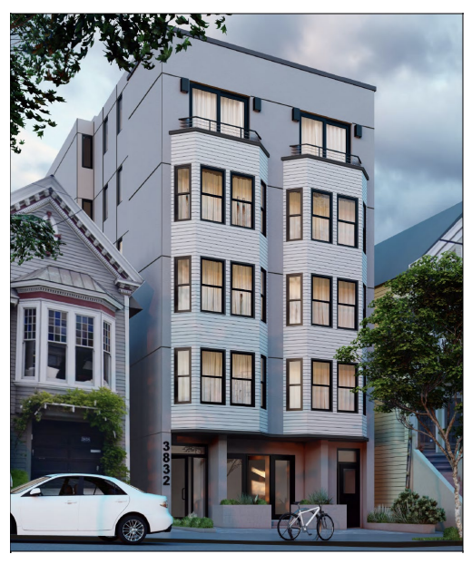
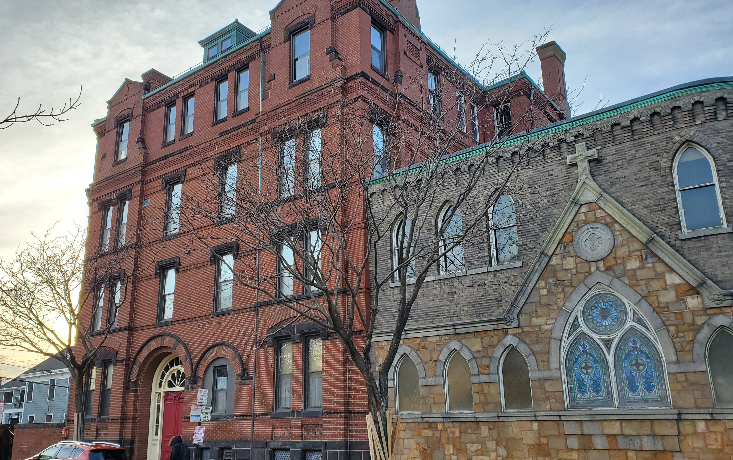
Zoning incentives, cont.

Slide 6
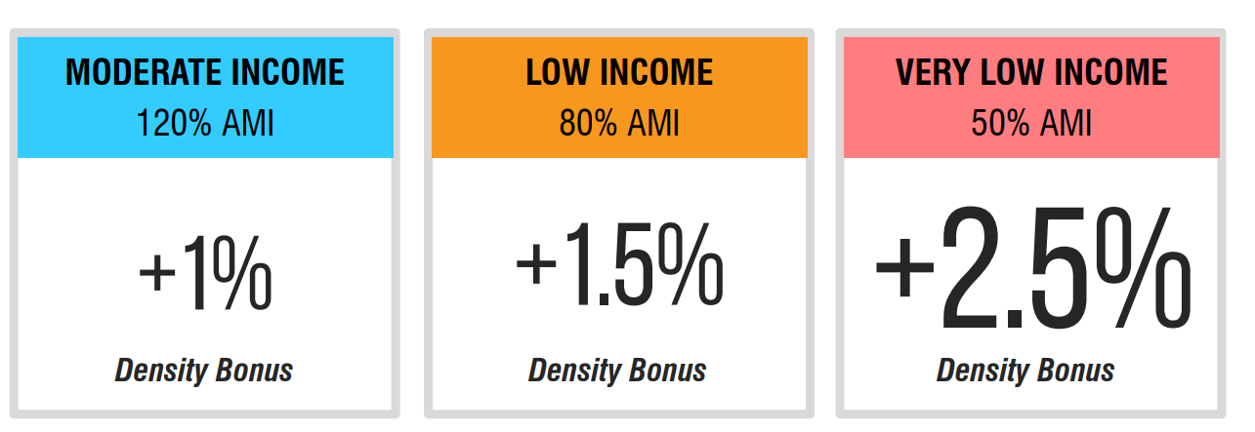
Zoning incentives, cont.
Density bonus formula = starting bonus + additional increments
20% density bonus for the first 5% of base units that are very low income
20% density bonus for the first 10% of base units that are low income
5% density bonus for the first 10% of base units that are moderate income
Total possible increase of 50% (with one exception)

Slide 7
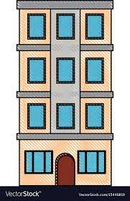
Zoning incentives, cont.
Project Version A:
The developer reserves 5% of base units (1/20) as very low-income housing, triggering a 20% density bonus (4 units)
The developer can now build 24 total units, 23 market-rate and 1 very low income
Developer will receive an additional 2.5% bonus for every additional 1% of base units that are very low income
Project Version B:
The developer reserves 10% of base units (2/20) as low-income housing, triggering a 20% density bonus (4 units)
The developer can now build 24 total units, 22 market-rate and 2 low income
The developer will receive an additional 1.5% density bonus for every additional 1% of base units that are low income

Slide 8
Zoning incentives, cont.
Project Version C:
The developer reserves 10% of base units (2/20) as moderate-income housing, triggering a 5% density bonus (1 unit)
The developer can now build 21 total units, 19 market-rate and 2 moderate income
The developer will receive an additional 1% density bonus for every additional 1% of base units that are moderate income

Slide 9
Comprehensive permit – procedural pain points
Simplify application requirements
Incorporate the procedural improvements recommended by the Land Use Commission
Narrow the criteria for who may challenge a comprehensive permit approval
Revise superior court appeal procedures for greater efficiency
Redesign the state housing appeals board (SHAB) for greater efficiency

Slide 10
Comprehensive permit – builder’s remedy
Adopt a stronger evidentiary standard for local board decisions
Shift the legal burden of proof to a municipality to justify a denial
Narrow and concretize the permissible grounds for denying an application
Eliminate special treatment of certain cities and towns

Slide 11
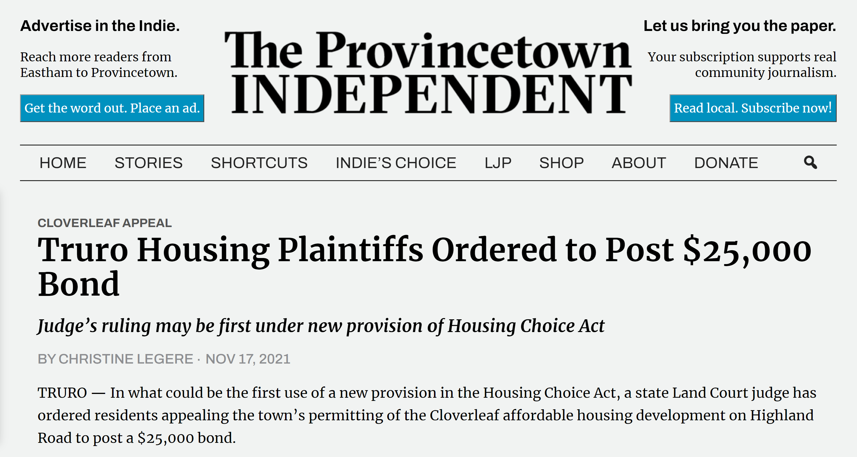
Comprehensive permit - accountability mechanisms
Allow the superior court to set appeals bonds for challenges to comprehensive permit approvals

Slide 12
Comprehensive permit - accountability mechanisms
Allow the superior court to temporarily suspend a municipality’s authority to decide comprehensive permits if the municipality repeatedly or egregiously violates state law
The redesigned state housing appeals board would review applications in place of the municipality for the period of the suspension

Slide 13
Summary
Offer by-right zoning incentives for low and moderate income housing.
Address procedural pain points.
Make the comprehensive permit a true “builder’s remedy.”
Increase accountability for bad-faith behavior.

